Slide 1

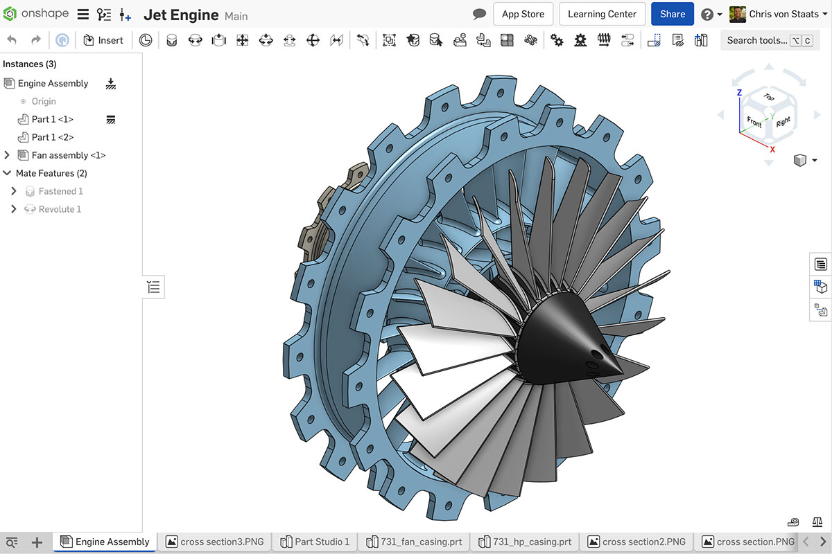
3D Modelling (using Onshape)

Slide 2
Signing up
I would recommend signing up with your personal email if you would like to access your models in the future (and your school email may block external emails if you sign up using it).
https://www.onshape.com/en/sign-up

Slide 3
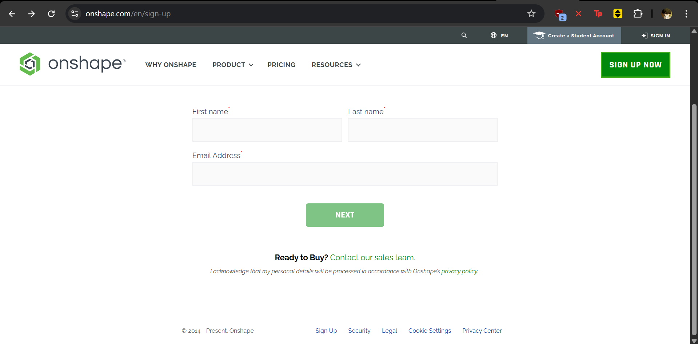
Step 1: Enter your name and personal email

Slide 4
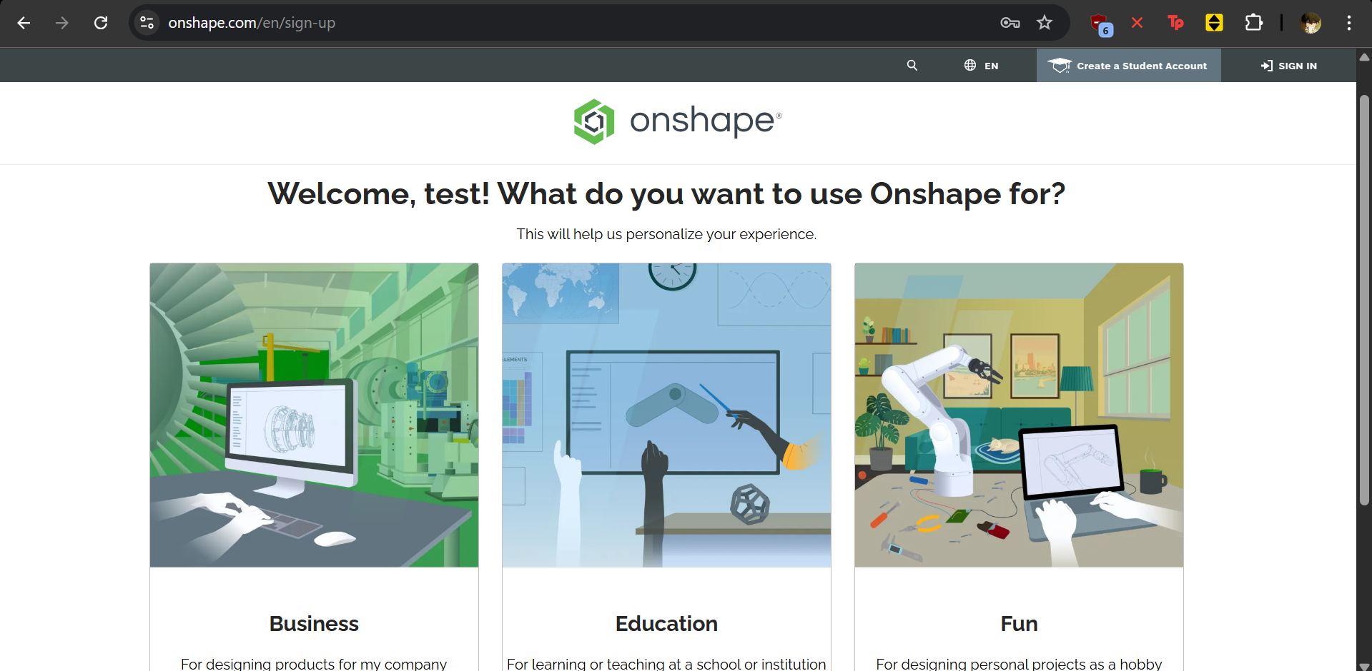
Step 2: Select Education

Slide 5
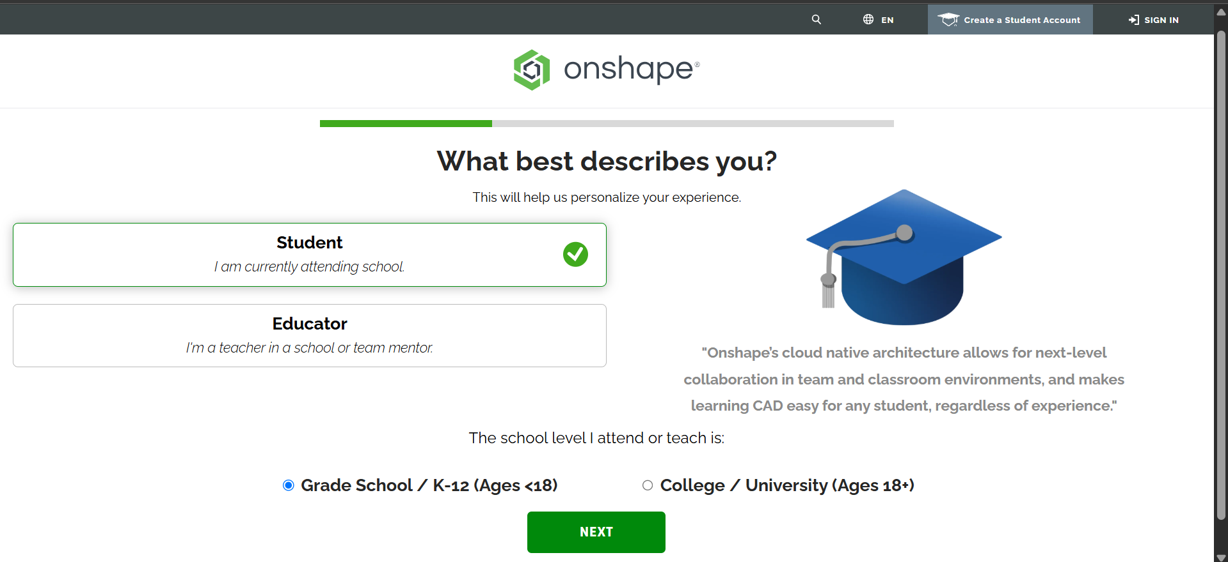
Step 3: Select “Student” and “Grade School/K-12”

Slide 6
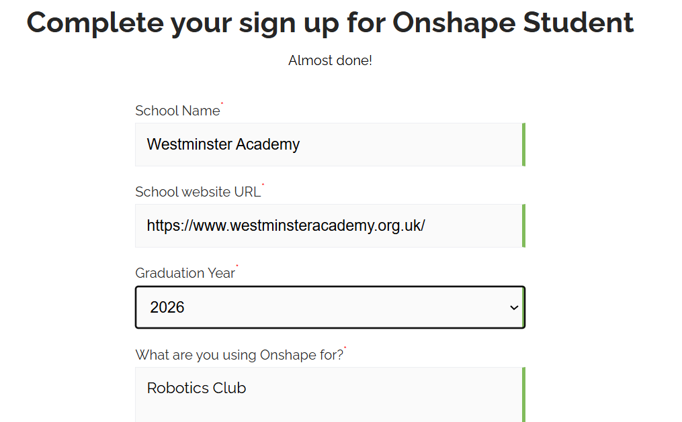
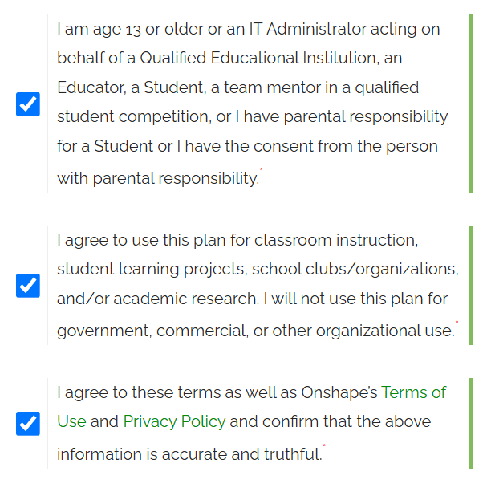
Step 4: Click “Next” on the next slide, then fill out the rest

Slide 7
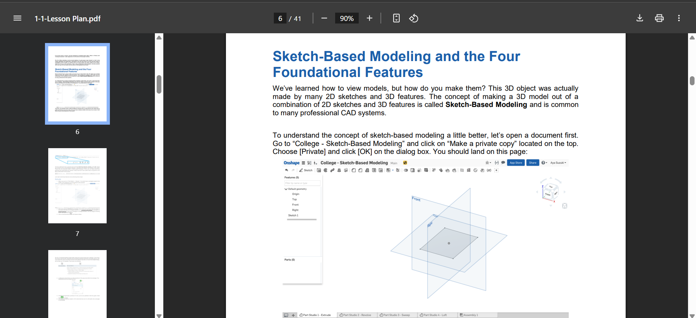
OnShapeGuide.pdf
Page 6

